Slide 1
STEWARDSHIP NAVIGATOR
a customizable stewardship workspace

Slide 6
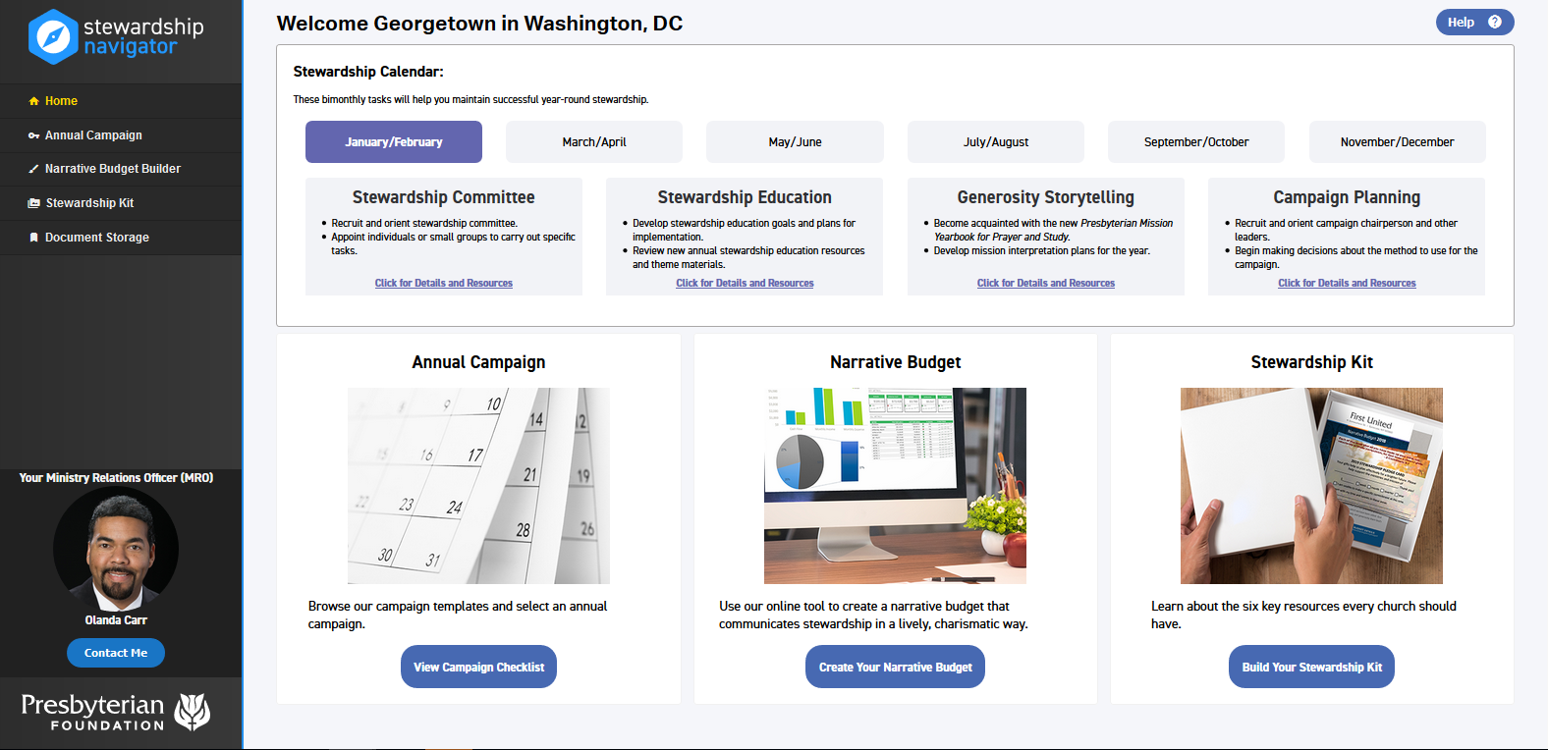
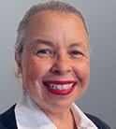
Menu
Stewardship Calendar
4
Annual Campaign Checklist
Create
Your
NARRATIVE BUDGET
Build
Your Stewardship Kit
Your Ministry Relations Officer (MRO)
Rose Niles
Help

Slide 7
4
Create
Your Narrative Budget
Your Ministry Relations Officer (MRO)
Rose Niles

Slide 8
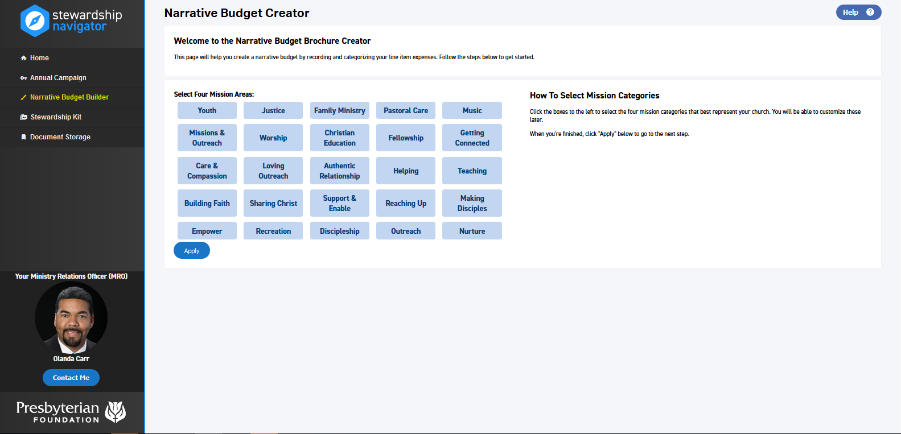
Your Ministry Relations Officer (MRO)
Rose Niles

Slide 9
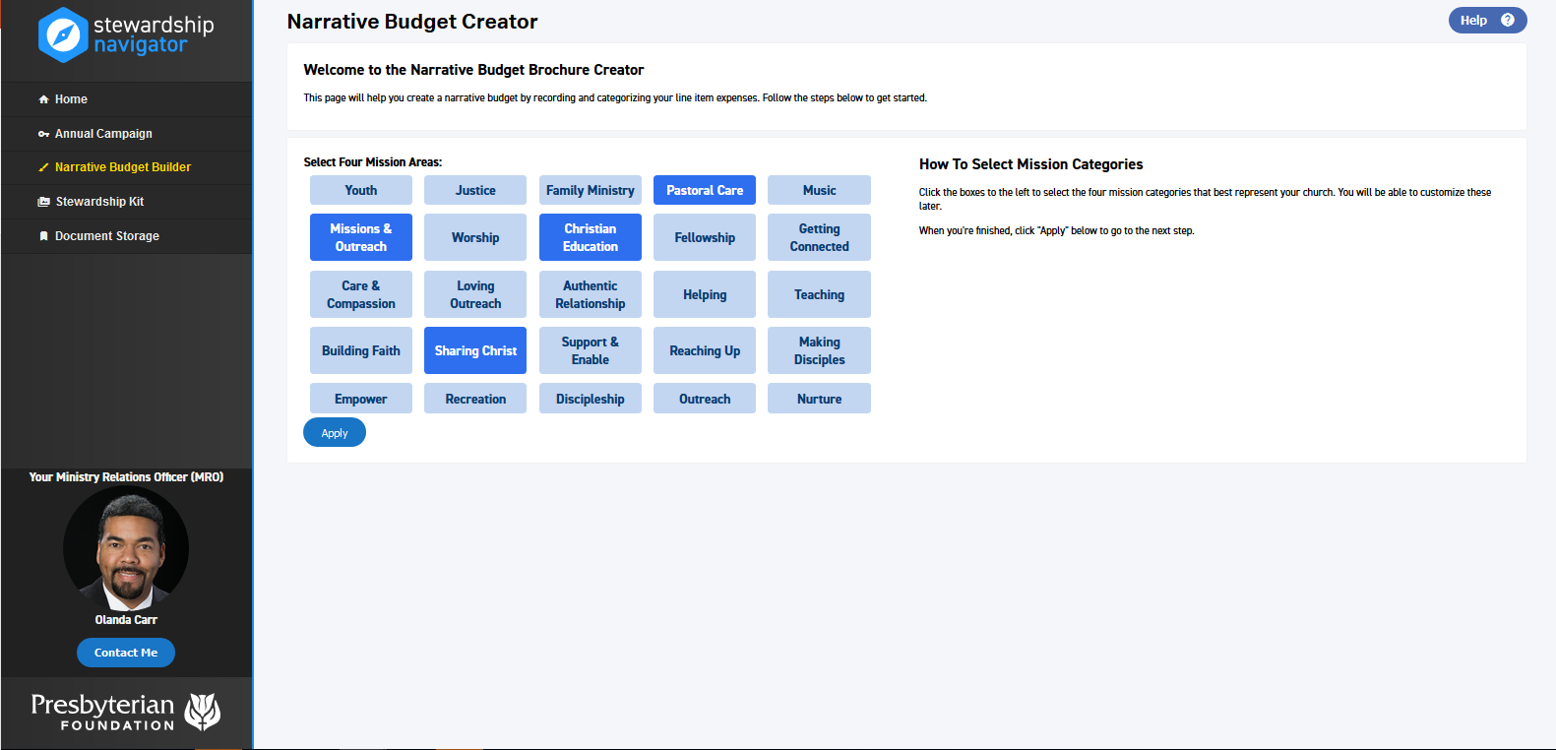
Your Ministry Relations Officer (MRO)
Rose Niles

Slide 10
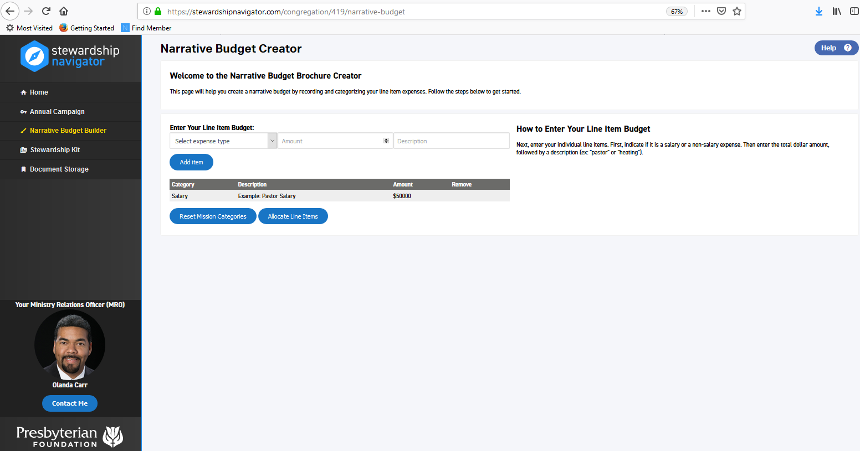
Your Ministry Relations Officer (MRO)
Rose Niles

Slide 11
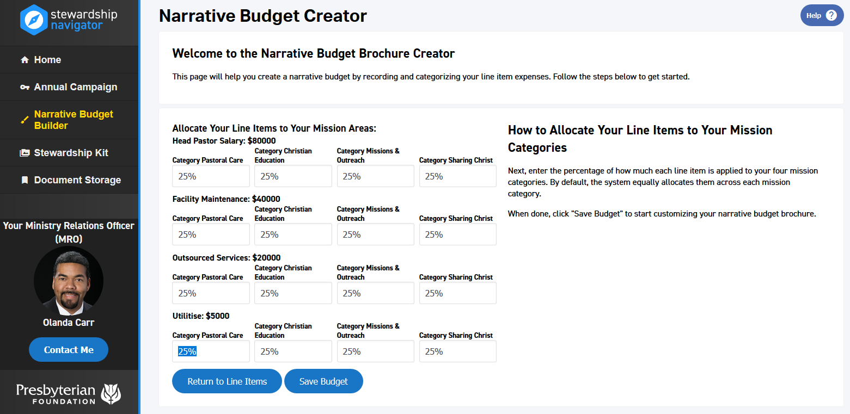
Your Ministry Relations Officer (MRO)
Rose Niles

Slide 12
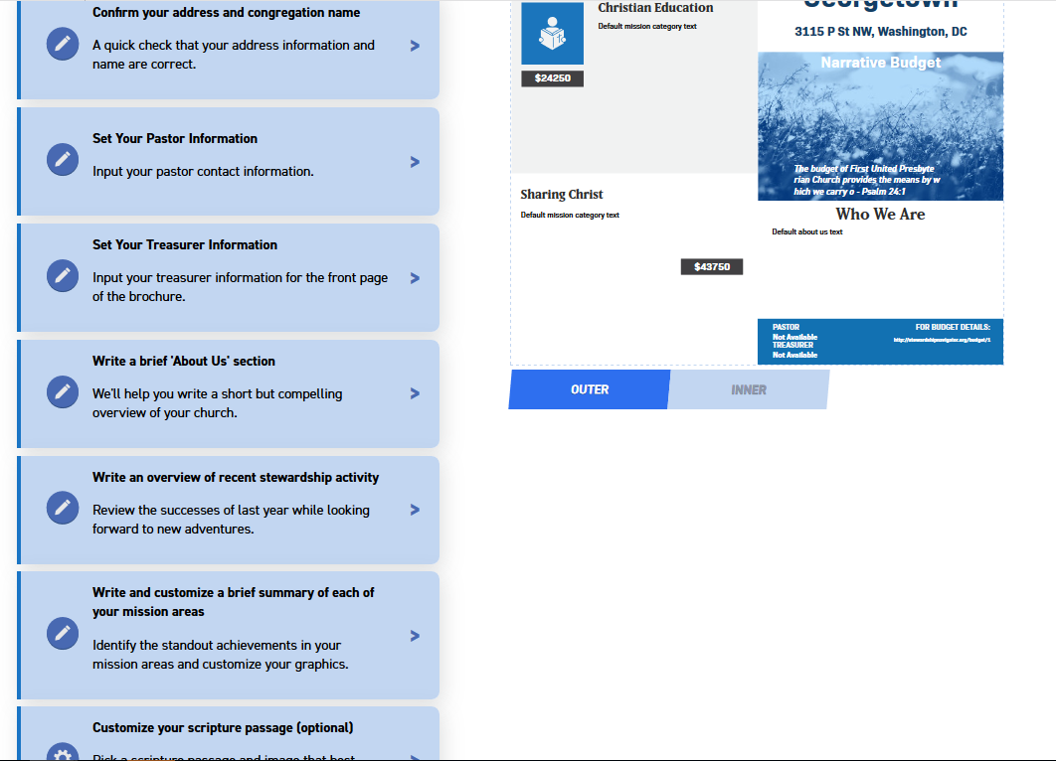
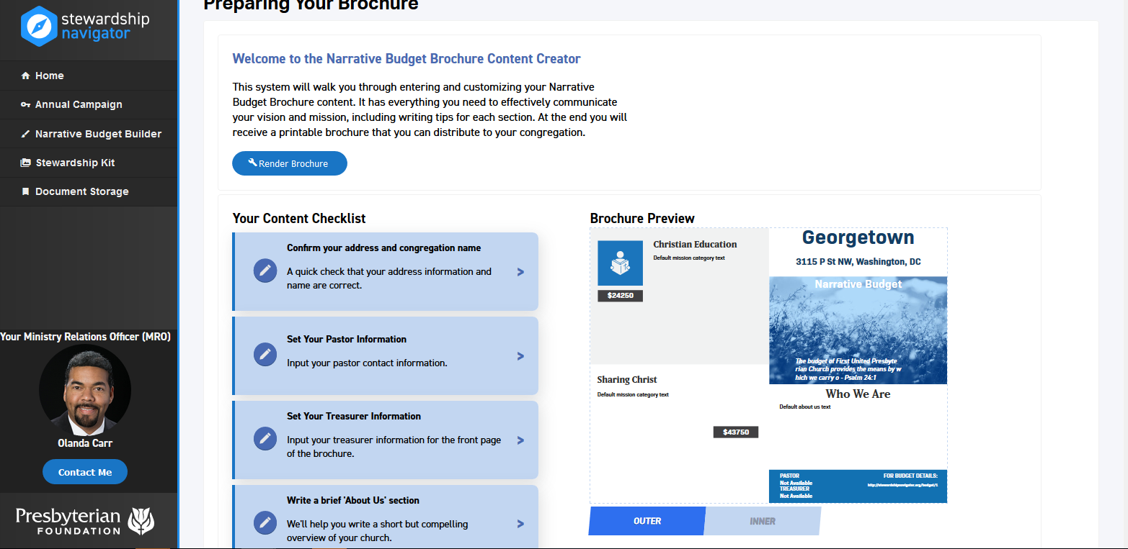
Your Ministry Relations Officer (MRO)
Rose Niles

Slide 13
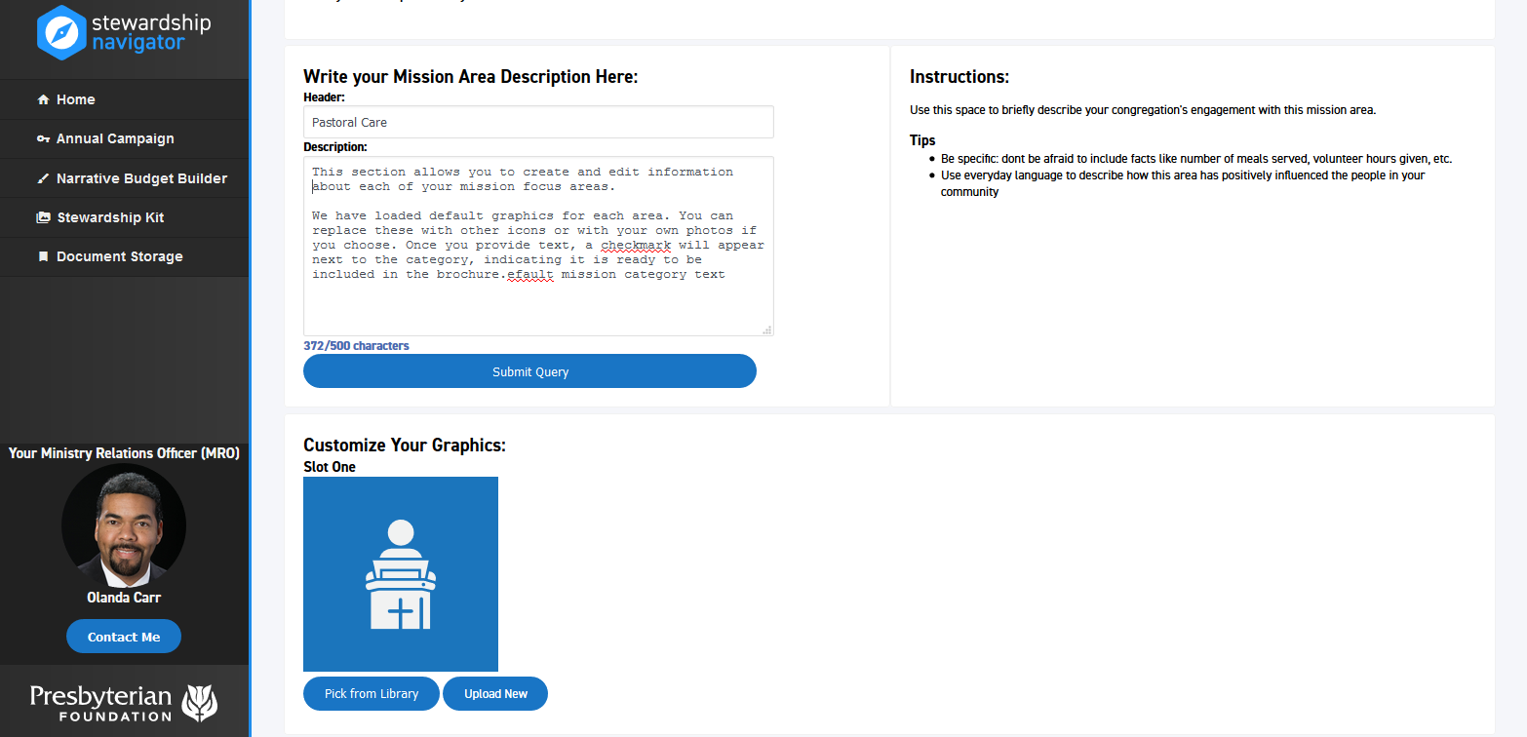
Your Ministry Relations Officer (MRO)
Rose Niles

Slide 14
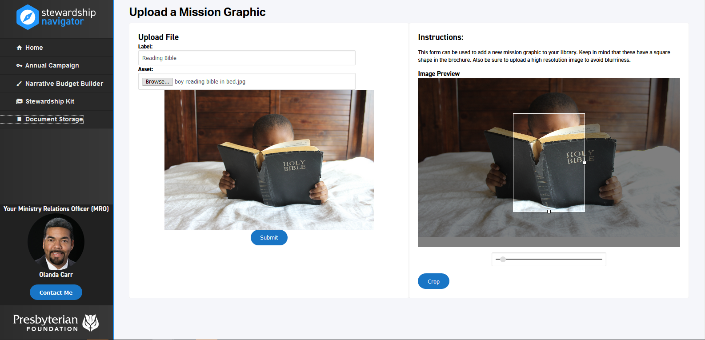
Your Ministry Relations Officer (MRO)
Rose Niles

