Slide 1
Narrative Budgets: How To? Synod of the Northeast Webinar
October 28, 2021, at 12:30PM ET
Rev. Dr. Rose Eileen Niles,
Ministry Relations Officer, Northeast Region

Slide 2
Speak your Vision: Narrative Budgets Work!
AKA: Let your budget
Notes:
What comes to your mind when you hear stewardship. Most of us think about money.
SignpostsofaFinanciallyHealthyCongregation This manual, with special emphasis on the annual financial stewardship program,will help pastors, sessions, and stewardship committees as they plan for the financial health of the congregation. Financial health speaks to our whole attitude about money, including how our understanding
of God’s goodness influences all of our financial decisions. Here are seven signposts that identify a financially healthy congregation:
» Understands that all giving, of ourselves as well as our financial resources, is in response to God’s
goodness and generosity. God gives, then we respond, and we spend our lives learning and growing in our responses.
» Discusses money in the context of worship instead of considering money a disreputable subject that should not be confused with the sacredness of worship.This distinction should not exist within Christ’s church.
» Understands that the offering is an integral part of corporate worship. Just as we bring our gifts of wine and bread to God’s table,we present ourselves as an offering through our financial gifts.
» Talks about money openly and candidly in all aspects of the church’s life, realizing that how we use our money says a great deal about our values and priorities.
» Engages in mission beyond its own doors and interprets this mission (both local and worldwide) through a planned year-round program. When people know how their money is used to do God’s work, they are reinforced in their giving.
» Plans long-range for its program objectives and financial needs.Budget development is a long-term process.
Stewardship.What do you think of when you see that word? Many of us think immediately of money. We recall that time in our congregation’s life when we are asked to make a financial commitment for the coming year. At some level, however, we are aware that stewardship is more than money. Stewardship is how we live out our calling as followers of Christ. Stewardship is what we do after we say that we

Slide 3
Luke 6:38 (The Message) Give away your life; you’ll find life given back, but not merely given back—given back with bonus and blessing. Giving, not getting is the way. Generosity begets generosity.
Prayer

Slide 4
Core Values and Vision
Who are you?
Where are you going?
What do you have to declare?

Slide 5
VALUES, VISION & MISSION
Values
A church’s principles or standards of behavior; its judgment of what is important
Synonyms: principles, ethics, moral code, standards, code of behavior
The principles on which the organization is built
Answers the question: What do we believe in?
They are how you do things
They have EVERYTHING to do with giving!
@LakeInstitute | #LakeECRF
50
Notes:
I experienced this in the two churches I served One was a tacit- the other was a surpising core value I did not have to wait to see unfold
Core Values are usually understood in these wayrs
Previous pastors- founding pastor
Present Pastor
Community in which they church resides in ministers
Fresno- fonding pastor came out of a tradition of defiing a walk of faith by oned doesno
Dancing
Plaing card
Drinking
Buidling- I will come and sit on the steps
Selcond Call- deifned by the founding pastor as welcoming, liberality, and grace. First thing are you sure you want to do that? Why not, we don’t have to do things we

Slide 6
CLARIFY YOUR MISSION
The Hedgehog Concept
52
@LakeInstitute | #LakeECRF
51
Notes:
Jim Collins in Good to Great talks about the five levels of leadership. The top tier leadership is one who has humility, a passion for the business and vision, and unswerving sense of excellence for the organization and the love of the associates/emploeees. Bottom line matrix is amount. Social sectors are different. Level 5 leadership still applies but the difference is excellence in leadership and passion for the orgranzation but the matrix is impact of lives.

Slide 7
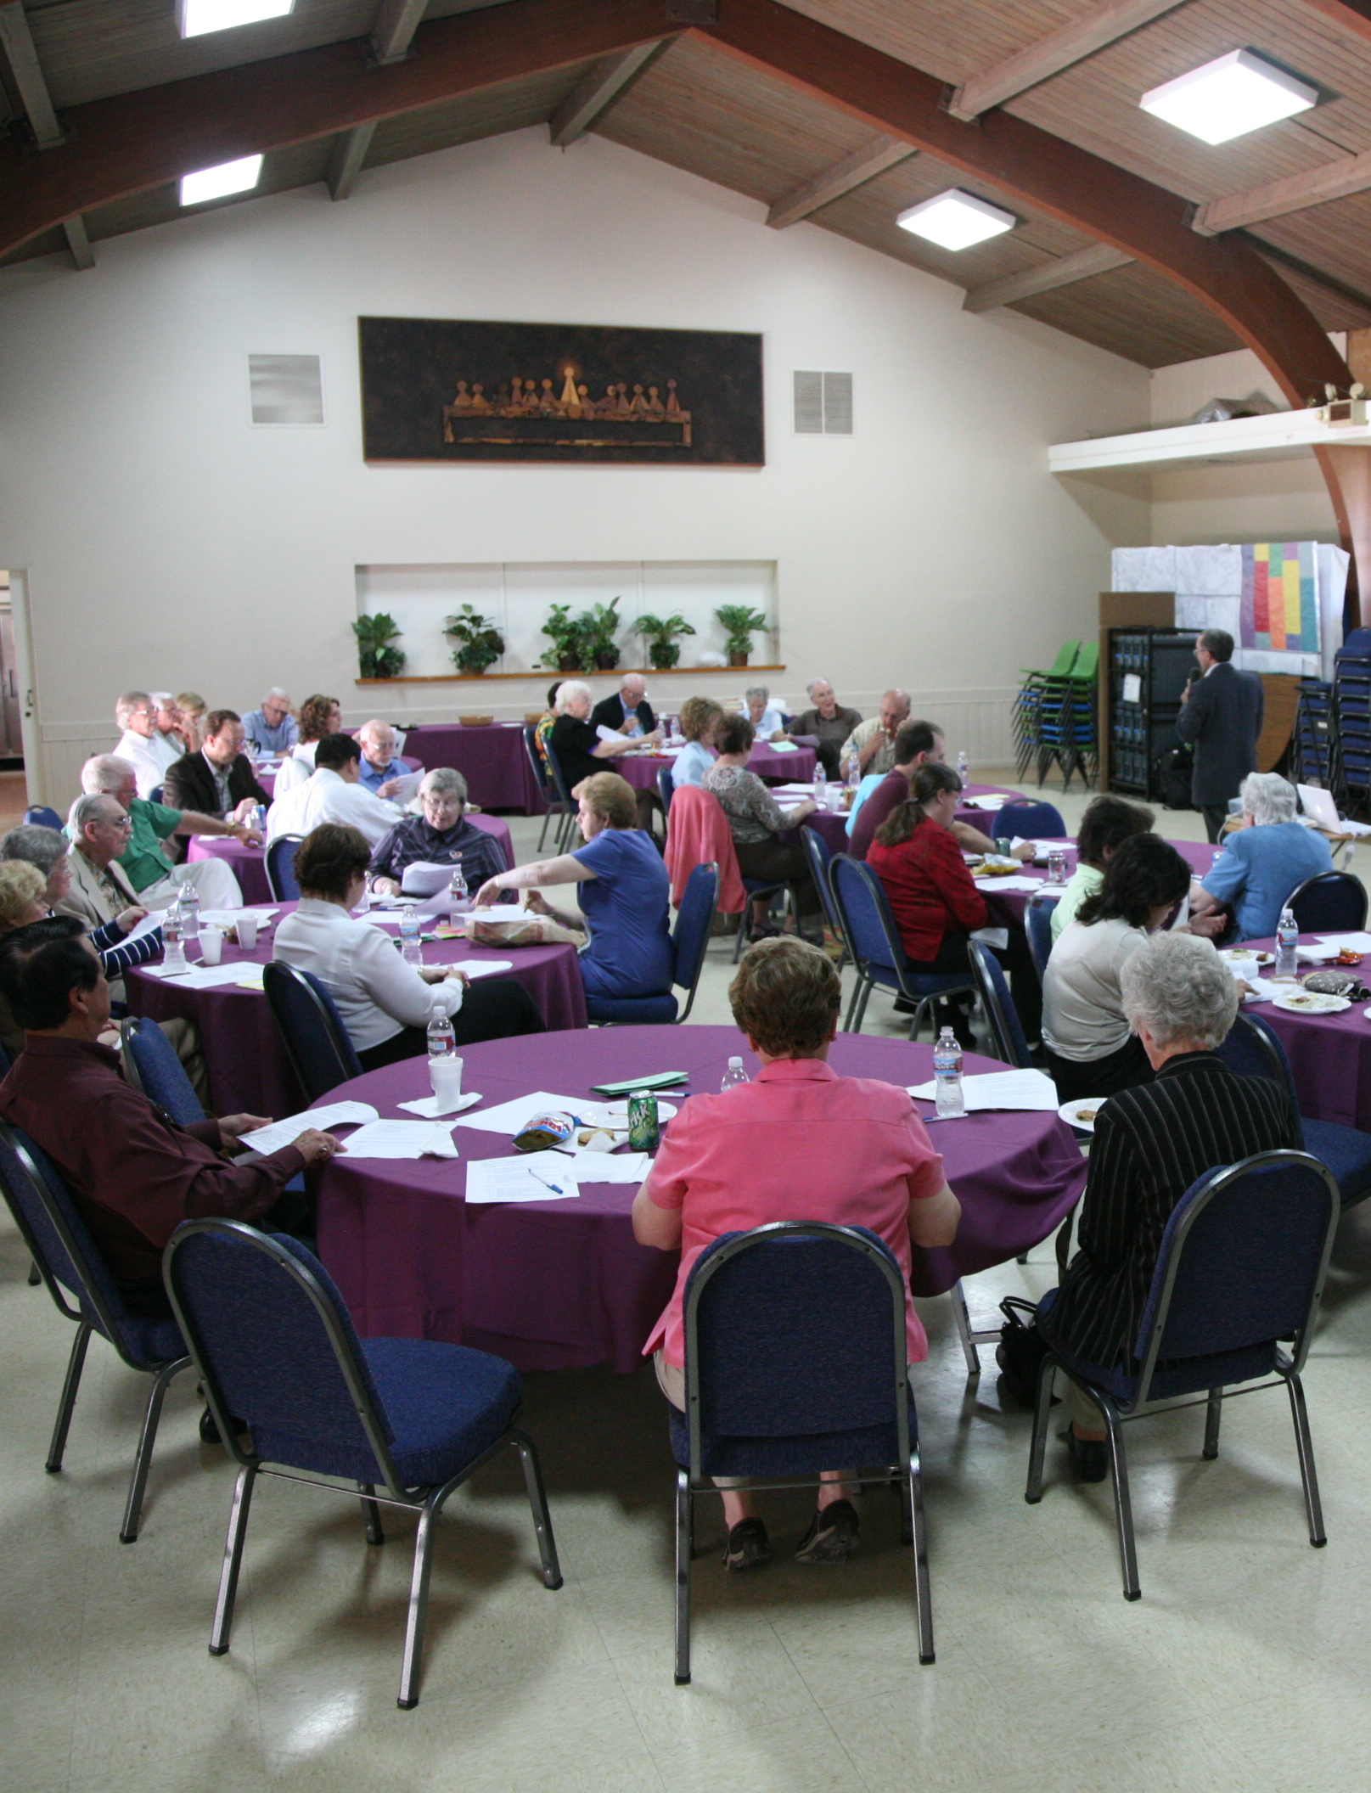
Visionary Church or Stagnate Church?
Visionary | Stagnate
Changed Lives | Balanced Budget
Need of the World | Guilt
Giving Changes the Giver | Giving balances the budget
Offering is a high moment | Offering is a time -out
Notes:
People who set on it:
Worship- stewardship begins to in worship. God touches are hearts. Worship is where all the community get together
CE- training the people and children at an early age
Finance- see the specifics
Youth- get their specifics
Offering we receive it…. Early service
Video stories…. Charter members

Slide 8
Telling impact stories

Slide 10
Budget
7 People
+
1 Dog
+
1 Car
IMPACT & STORY
FACTS & FIGURES
Line Item
or
Narrative
Notes:
Many churches use Quick Books and is not easy to understand. Very complicated. Members of the church are confused. Some will want them
Give it to the Church…presbyterial system and not a congregational system.
Mmbers need to know notthe dollars but what the dollars are doing
Worship- cost gets spread out
Pastor
Music
Calculate the time and energy that would have cost in dollar value.
Ministry areas of important to our church….like????
What has been valuable…show pcitures…children, action, smiling. Computer prograns can do it.
Color…people recognize passion
Share the vision. Video and testimonials. Charter members praing in worship by video.
Don’t do math in public. Don’t say staff is the largest part of the budget…narrative budget. Staff should be 50-55 percent of the budet. Higher produces growth lower does not. Too higher problems.
Allows you to tell stories. Fact are our friends as well.
How they relate to the vision. Peole come to know Christ. People who have been afftect.
Everyone likes to feed a fat hog. If it is growing peole like to feed it.
Fly wheel principles…once that fly wheel beings it begins to flow and grow…momentum

Slide 11
Road Trip! Norman Rockwell, The Saturday Evening Post (No Copyright Infringement Intended)

Slide 22
A Narrative Equips your Church to…
Use ministry categories rather than line items
Reframe gifts as investments in ministry instead of just “the light bill”
Inspire givers by showing impact
Increase financial resources for the ministry!
Tell the Vision and Core Values

Slide 24
Select Ministry Categories
Worship
Education (or Spiritual Formation)
Mission (or Outreach)
Fellowship (or Nurture)
Pastoral Care
And many more….
These categories will not match your
budget categories!!

Slide 25
Key Resource: Stewardship Navigator

Slide 26
Four to Six Categories, Please!
All line items are assigned or split up into
one or more categories.
Salaries are assigned across categories
Youth Ministry? Education or Fellowship & Education
Missions or Education?
Add or modify categories to fit your ministry, keep only 4 to 6 categories

Slide 27
What Category is NOT listed?
Worship
Education (or Spiritual Formation)
Mission (or Outreach)
Fellowship (or Nurture)
Pastoral Care
Do you see ADMINISTRATION anywhere?

Slide 28
Warning!!!
Using ADMINISTRATION or BUILDING or DEBT or INFRASTRUCTURE as a Category will…
UNDERMINE the impact
of this ministry resource
and render your efforts ineffective!!!
We BEG you. Don’t go there!
Notes:
This is a marketing tool, not an accounting exercise. Generosity will be inspired by the stories not by the numbers.

Slide 29
EXCEL: Percentage Columns
Create a column for each category. Format cells as percentages.
Distribute pastoral costs by percentage of time across categories.
Distribute percentages of line items into category columns. Some will be easy!
i.e. Sunday School supplies to Education
Notes:
A time audit isn’t necessary, however fruitful conversation about priorities may arise. Consider activity level of congregational ministry. A church with multiple worship services will probably allocate more pastoral time to worship. A small church without weekday activities may also allocate more resources to worship. Very active churches with multiple weekday ministries will distribute costs more evenly across categories.
This is the place where most groups get stuck. I often draft the percentages for the church using rough estimates of congregational activity and use of property. This allows the church to focus on the narrative materials – which we will talk about later.
I assign all apportionments or mission shares to the Mission category as these all represent funds going beyond the church’s ministry setting. Direct billed costs from the Conference are distributed the same way as pastoral compensation if they are related to the pastor and the same way as other building use items for things like insurance.
Some times a church budget is organized so that a whole category can be distributed using the section total rather than distributing each line item – that saves a lot of time!
And always double check the math – percentages need to equal 100%!

Slide 30
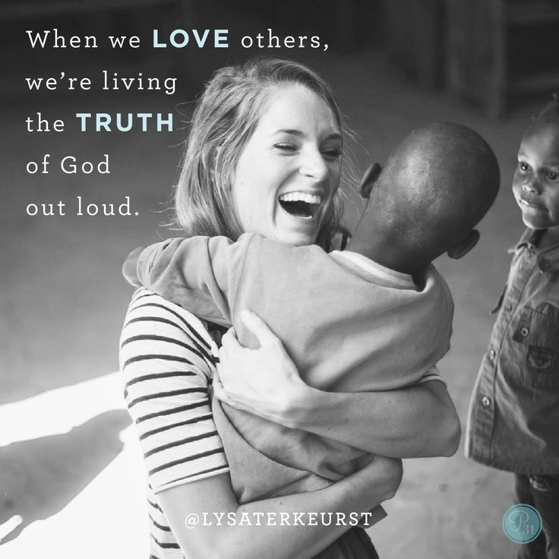
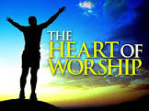
A pastor might spend their time in this manner:
30% on Worship
15% on Education
10% on Mission
10% on Fellowship
20% on Pastoral Care
This distribution will inform other expense lines.
Building usage may impact some expenses.

Slide 31
Avoid the Accuracy Trap
Detailed accuracy is less important than being descriptive, educational and inspiration!
Accept that the results will have a positive impact on donors even when based on some generalizations.
Notes:
When implementing a Narrative Budget for the first time some churches get stuck seeking detailed accuracy rather than allowing the Narrative Budget to be descriptive, educational and inspirational!
As an educational tool, it is more important to encourage givers to think about how their giving is used for ministry. Try to be as accurate as possible. Accept that the results will have impact even when based on some generalizations.

Slide 32
Example…
Worship & Music |  |  |  |  | $4,500
Education/Spiritual Formation |  |  |  |  | $6,000
Mission |  |  |  |  | $28,000
Membership – Small Groups |  |  |  |  | $2,000
Pastoral Compensation |  |  |  |  | $76,000
Staff Parish - Other |  |  |  |  | $56,000
Property |  |  |  |  | $93,932
Programs & Communications |  |  |  |  | $8,000

Slide 33
Percentage Allocations
 |  |  |  |  |  |  | Worship | Education | Mission | Fellowship Pastoral Ca
Worship & Music |  |  |  |  | $4,500 |  | 100%
Christian Ed/Spiritual Formation |  |  |  |  | $6,000 |  |  | 100%
Mission |  |  |  |  | $28,000 |  |  |  | 100%
Membership - Small Groups |  |  |  |  | $2,000 |  |  |  |  | 100%
Pastoral Compensation |  |  |  |  | $76,000 |  | 35% | 20% | 10% | 10% | 25%
Staff Parish - Other Staff |  |  |  |  | $56,000 |  | 40% | 25% | 15% | 15% | 5%
Property - all costs |  |  |  |  | $93,932 |  | 25% | 30% | 15% | 20% | 10%
Programs & Communications |  |  |  |  | $8,000 |  | 25% | 25% | 25% | 25%
Total |  |  |  |  | $274,432
Notes:
Note – Staff parish typically has to broken out into staff position – with choir director/musicians/childcare staff all going 100& to Worship while others are spread out.

Slide 34
Ministry Category Totals!
Add another set of ministry category columns
Multiply the percentage column by the budget line item amount
Total ministry categories columns
Column totals are ministry category totals
Notes:
Add another set of columns with the same ministry categories and multiply the percentage column by the budget line item amount to get dollar amounts for each assigned percentage.
Total columns for ministry categories amounts and then calculate percentage of church budget.

Slide 35
Percentages for Narrative
 |  |  |  | Worship | Education | Mission | Fellowship Pastoral Care
Worship & Music |  |  | $4,500 | $4,500 | 0 | 0 | 0 | 0
Christian Ed/Spiritual Formation |  |  | $6,000 | 0 | $6,000 | 0 | 0 | 0
Mission |  |  | $28,000 | 0 | 0 | $28,000 | 0 | 0
Membership - Small Groups |  |  | $2,000 | 0 | 0 | 0 | $2,000 | 0
Pastoral Compensation |  |  | $76,000 | $26,600 | $15,200 | $7,600 | $7,600 | $19,000
Staff Parish - Other Staff |  |  | $56,000 | $22,400 | $14,000 | $8,400 | $8,400 | $2,800
Property - all costs |  |  | $93,932 | $23,483 | $28,180 | $14,090 | $18,786 | $9,393
Programs & Communications |  |  | $8,000 | $2,000 | $2,000 | $2,000 | $2,000 | 0
TOTAL |  |  | $274,432 | $78,983 | $65,380 | $60,090 | $38,786 | $31,193
 |  |  |  | 29% | 24% | 22% | 14% | 11%
Notes:
Add another set of columns with the same ministry categories and multiply the percentage column by the budget line item amount to get dollar amounts for each assigned percentage.
Total columns for ministry categories amounts and then calculate percentage of church budget.

Slide 36
Select Category Totals to Create a Pie Chart

Slide 37
Givers Can Translate Their Giving…
11 cents of every dollar I give goes to Pastoral Care
22 cents of every dollar I give goes to Mission
The pie chart can lead to
congregational
self-evaluation and affirmation!

Slide 38
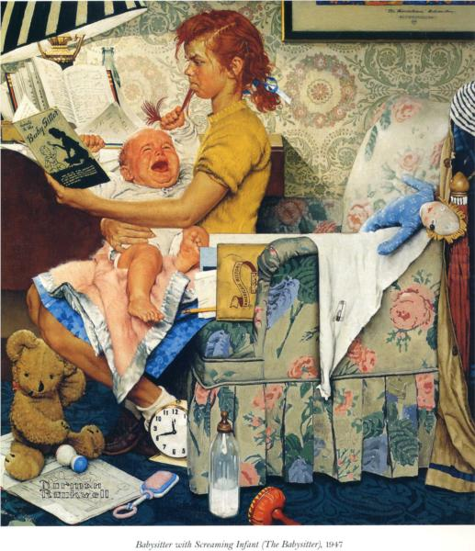
Tell the Story
Share a description
and stories about
the ministry categories
Notes:
The pie chart can not be adjusted after being pasted into another document. To revise, go back to the excel spread sheet and adjust there!
A narrative for Mission can describe both projects and testimonials
A narrative for Fellowship invites people to participate in events and activities
A narrative for Pastoral Care tells members about pastoral services

Slide 39
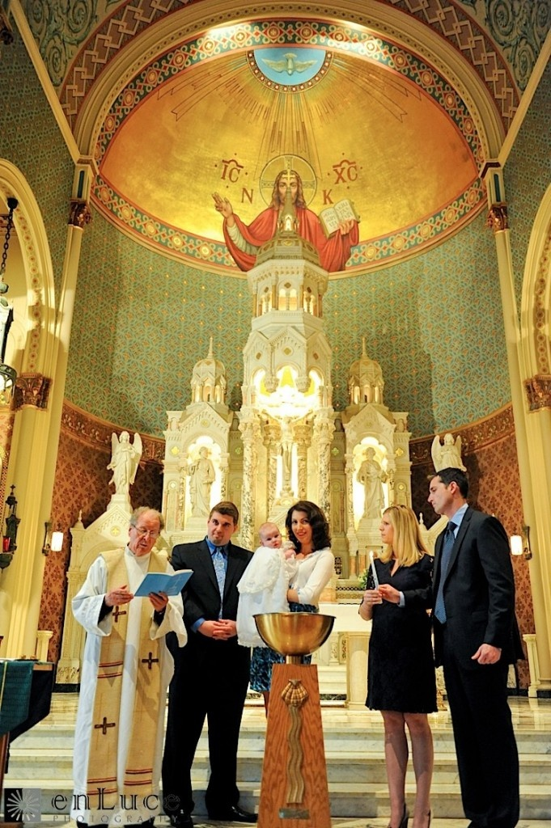
Pastoral Care Narrative
Taking communion to three local nursing homes each month
On call at two local hospitals and follow up care for parishioners recovering from illness and surgery
Preparation with the members for baptisms and weddings.

Slide 40
Sacred Stories
Kristen is a young mom new to the community. Her family is over 300 miles away. She has been having a difficult time with her children and the public schools. Her mother was badly hurt in a car accident last month and Kristen misses home and wants to find some part-time work. She walked in off the street last Wednesday morning and she found a friendly ear in the church office. She feels comfortable with the pastor and has come to church the last few Sundays feeling like she is beginning to create a new “family” here in this community.

Slide 41
Get the Story Out…
Church Newsletter
Bulletin Inserts
Church Website
Stewardship Mailings
Narrative Budget Booklets
Personal Contact
Include in Prayers

Slide 42
Worship Narratives
Put a bulletin insert out each week for six weeks highlighting a different category of ministry
Pray for that ministry
Tell a specific story of a person being touched by that ministry

Slide 43
Add a Time and Talent Option
Additional data can illustrate volunteer hours which supplement financial gifts
Parishioners get a sense of how vital and vibrant the local church is when looked at in the context of time contributions

Slide 44
Volunteer Time Calculation Example
Sunday Morning Worship
Greeters, Fellowship Hosts/coffee makers – four to eight persons, 8 X 1.5 hours = 12 hours
Liturgists, communion servers, counters, ushers, 10 X 1.5 hours = 15 hours
Choir – ten members X 2 hours of worship and 2 hours of practice time = 40 hours
Almost 70 hours of servant time in one week X 52 weeks = 3,640 hours of time given for Sunday morning worship alone!

Slide 45
In an average size church
When all ministries are considered, a reasonable estimate is 10,000 – 15,000 volunteer hours per year
That’s a significant impact on any local community!!

Slide 46
A Few Recommendations…
Experiment with leaving line item budget in church office
Take only Narrative Budget to your Church Council
Keep five copies of the completed line item budget available in the church office
Be determined to talk about money and ministry in a new way

Slide 47
The Process Continues…
Quarterly review, update and expand upon stories and talent recognition
People will begin to think of church ministry funding as ministry!
“Giving doesn’t just make a difference,
it can make ALL the difference!”
Notes:
It takes pretty major changes to impact the pie chart percentages, those change rather slowly.

Slide 50
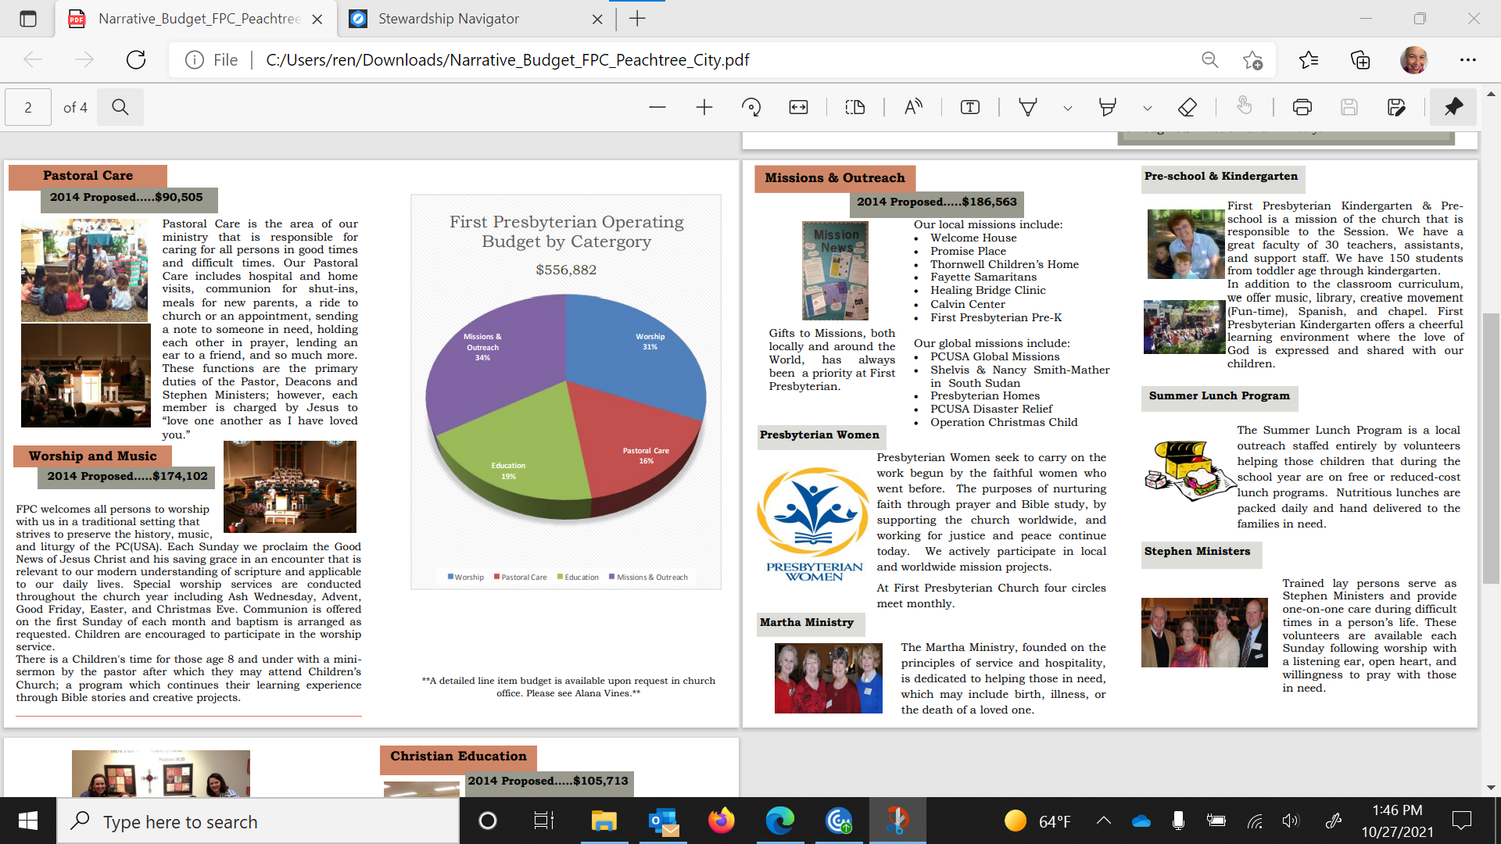

Slide 51
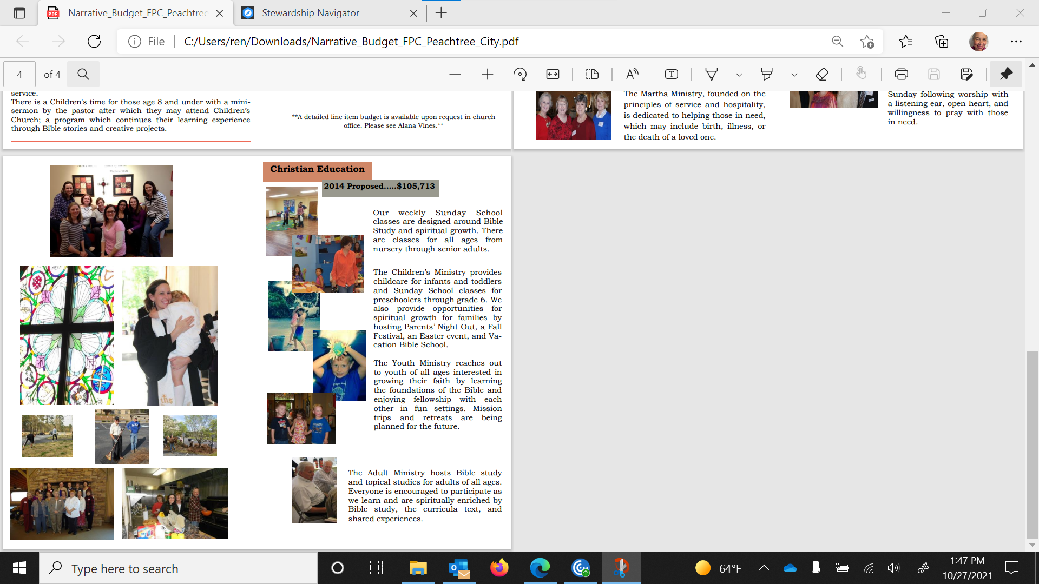

Slide 52
Free Resources from the Presbyterian Foundation
1. Stewardship Navigator
Launched April 2019
Planned Giving Module added July 2020
Narrative Budget Generator Included
www.stewardshipnavigator.com\
2 Church Financial Leadership Academy
Many topics including Narrative Budget
www.churchfla.com
Register using code: PCUSA
3. Stewardship Kaleidoscope
2022 In-Person or Virtual
For more information
www.stewardshipkaleidoscope.org
Day of Learning Recordings
https://www.presbyterianfoundation.org/resources-from-presbyterian-foundation-day-of-learning-2021/
Various Workshops from your MRO

Slide 53
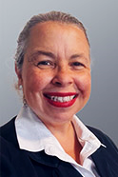
Reverend Dr. Rose Niles
Ministry Relations Officer, NE Region Presbyterian Foundation
As a life-long Presbyterian, Rose loves working with churches and individuals to help them flourish and further the mission of Christ.
Rose helps cultivate generosity through seminars, workshops, legacy programs, creating fundraising plans, nurtures gift development, and provides finance coaching .
YOUR
VISION IS OUR VISION WE CAN HELP.
Seminars/Workshops/Webinars/Consultation
Culture of Generosity Begin the conversation
Leadership Vital for building a culture of generosity
Pastoral Challenges in Stewardship How to deal with the issue of stewardship and talk about money effectively
Visioning Money follows vision. Vision and core-values are essential
Narrative Budget Budget should speak your vision
Generational Giving Learn to approach giving across generations
E-Giving Ways to give are quickly changing
Build an Endowment Help people give in perpetuity for future ministry
Planned Giving Leaving a legacy to the next generation
Investments Understanding the various investment options available through the Presbyterian Foundation, PCUSA
Consultation Meet with individuals and groups regarding finance, stewardship best practices, giving trends today, how to build a year-long program, inspire and build a spiritual discipline for giving
Rev. Dr. Rose Niles, Ministry Relations Officer – Northeast Region toll-free 833.461.2307 rose.niles@presbyterianfoundation.org

Slide 54
Speak your Vision
Let your budget
Questions and Comments
Notes:
What comes to your mind when you hear stewardship. Most of us think about money.
SignpostsofaFinanciallyHealthyCongregation This manual, with special emphasis on the annual financial stewardship program,will help pastors, sessions, and stewardship committees as they plan for the financial health of the congregation. Financial health speaks to our whole attitude about money, including how our understanding
of God’s goodness influences all of our financial decisions. Here are seven signposts that identify a financially healthy congregation:
» Understands that all giving, of ourselves as well as our financial resources, is in response to God’s
goodness and generosity. God gives, then we respond, and we spend our lives learning and growing in our responses.
» Discusses money in the context of worship instead of considering money a disreputable subject that should not be confused with the sacredness of worship.This distinction should not exist within Christ’s church.
» Understands that the offering is an integral part of corporate worship. Just as we bring our gifts of wine and bread to God’s table,we present ourselves as an offering through our financial gifts.
» Talks about money openly and candidly in all aspects of the church’s life, realizing that how we use our money says a great deal about our values and priorities.
» Engages in mission beyond its own doors and interprets this mission (both local and worldwide) through a planned year-round program. When people know how their money is used to do God’s work, they are reinforced in their giving.
» Plans long-range for its program objectives and financial needs.Budget development is a long-term process.
Stewardship.What do you think of when you see that word? Many of us think immediately of money. We recall that time in our congregation’s life when we are asked to make a financial commitment for the coming year. At some level, however, we are aware that stewardship is more than money. Stewardship is how we live out our calling as followers of Christ. Stewardship is what we do after we say that we

Slide 55
The Rev. Dr. Rose Eileen Niles
Ministry Relations Officer for the Northeast
7 Marion Ct.
Middletown, NY 10941
845-326-6501 /833.461.2307 (toll free)
Rose.Niles@PresbyterianFoundation.org

